Slide 1
DATA ANALYSIS PROJECT
Mai Huy Khang

Slide 2


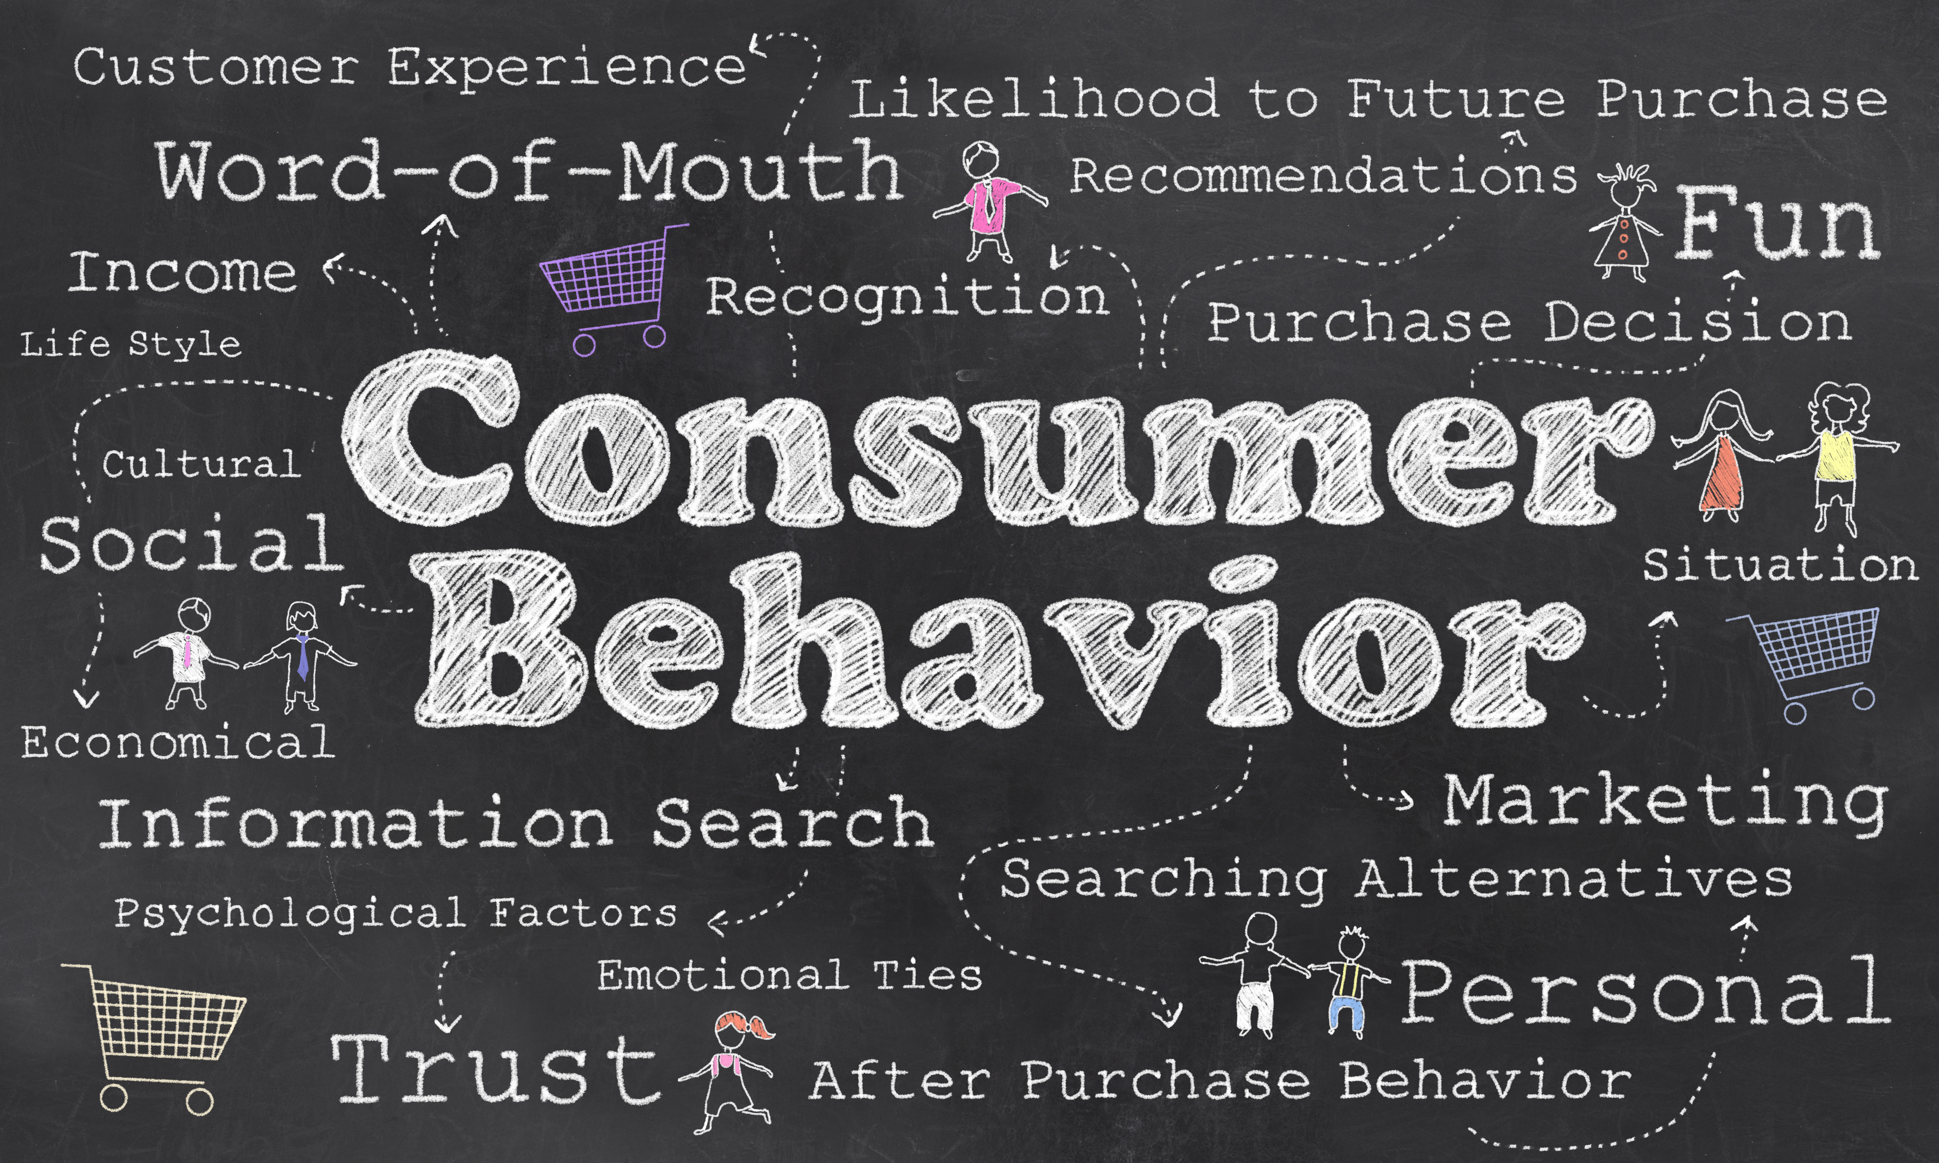





Slide 3
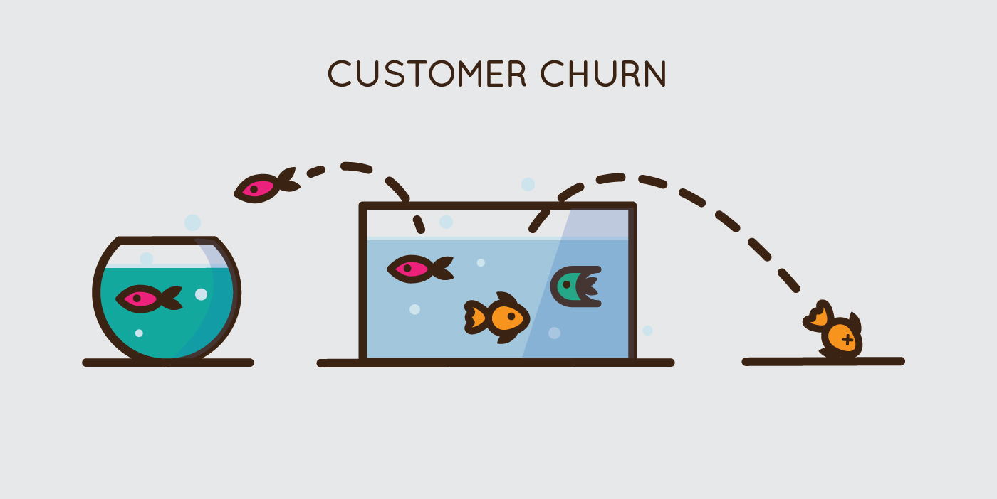
This concept refers to a situation in which customers leave and stop using a company's product or service for a period of time. Usually, the company will measure and analyze to evaluate the effectiveness of its business and marketing strategy based on this indicator.

Slide 4
TABLE OF CONTENTS
01
DATASET DISCOVERY
02
03
DATA PREPROCESSING
EDA
04
05
06
07
SOLUTION
FEATURE ENGINEERING
BULDING AND TRAING MODEL
FEATURE IMPORTANCE

Slide 5
Dataset Discovery
ABOUT DATASET
The dataset with 3388 records and 20 contributors, including:
Account length: How many days the user has been a member of the site.
Add to cart per session: User's average of adding to cart per session.
Add to wishlist: Number of times the user has added products to the wish list.
App sessions: Number of user's app sessions.
App transactions: The number of purchases made by the user on the app.
Avg order value: User's average order amount
Credit card info save: Information whether the user has saved the credit card in the system.
Customer service calls: Number of user calls to customer service
Churn: Information whether the user is churn | Target Variance
TỈ LỆ BỎ HỌC CỦA SINH VIÊN LÀ MỘT VẤN ĐỀ NAN GIẢI CHO CÁC CẤP CƠ SỞ CAO HỌC ĐỂ ĐÓNG GÓP VÀO SỰ PHÁT TRIỂN NÀY.

Slide 6
Dataset Discovery
ABOUT DATASET
The dataset with 3388 records and 20 contributors, including:
Desktop sessions: Number of user's desktop sessions.
Desktop transactions: The number of purchases made by the user from the desktop.
Discount rate per visited products: Average discount rate of products viewed by the user.
Location code: User's location code
Product detail view per app session: Average number of products users viewed detail per session.
Promotion clicks: Number of times user clicks on discount offers.
Push status: Whether the user allows notifications or not.
Sale product views: User's discounted product views
Session duration: Average time spent by the user in their session.
Total product detail reviews: User's product detail views.
User id: Unique ID assigned to the user.
TỈ LỆ BỎ HỌC CỦA SINH VIÊN LÀ MỘT VẤN ĐỀ NAN GIẢI CHO CÁC CẤP CƠ SỞ CAO HỌC ĐỂ ĐÓNG GÓP VÀO SỰ PHÁT TRIỂN NÀY.

Slide 7
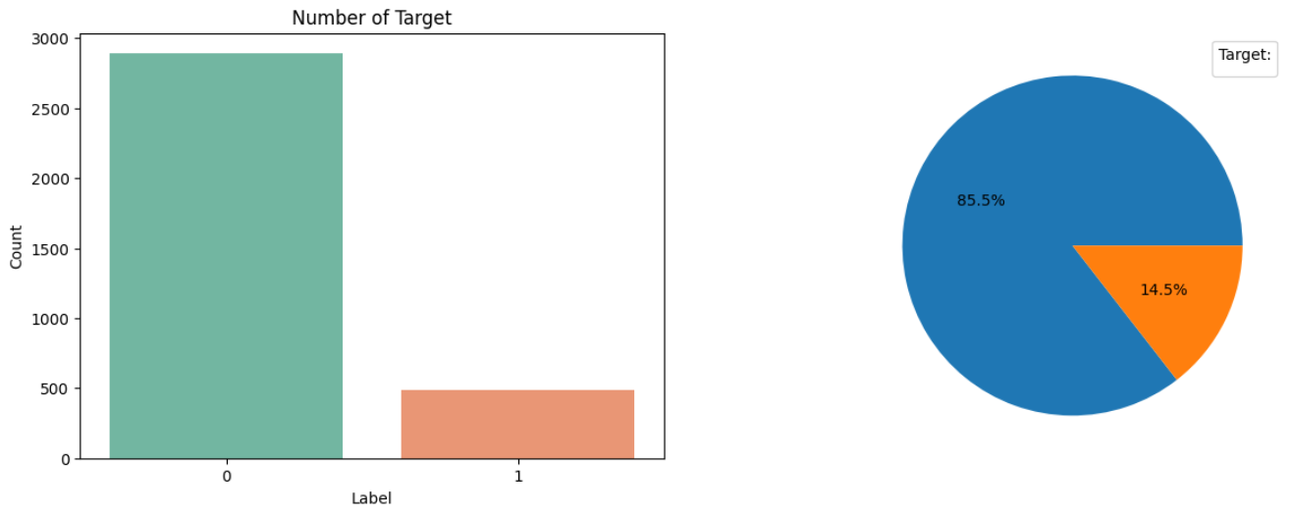
TARGET VARIANCE
The churn variable will be our target variable with two values of 0 and 1 representing the group of customers who remain and the group of customers who have left, respectively. Therefore, the initial orientation of the model in the article will be classification models.
TỈ LỆ BỎ HỌC CỦA SINH VIÊN LÀ MỘT VẤN ĐỀ NAN GIẢI CHO CÁC CẤP CƠ SỞ CAO HỌC ĐỂ ĐÓNG GÓP VÀO SỰ PHÁT TRIỂN NÀY.

Slide 8
02
DATA PREPROCESSING

Slide 9
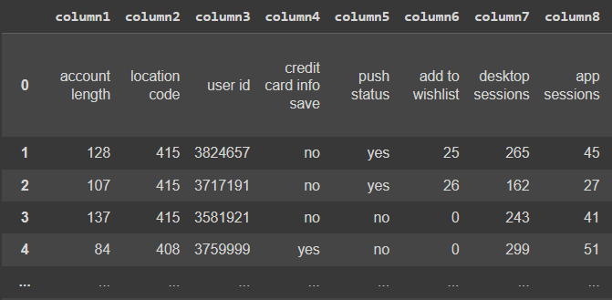
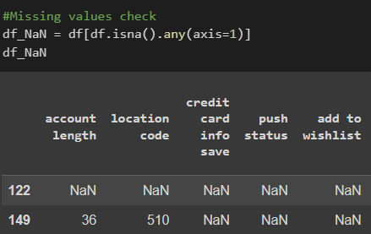
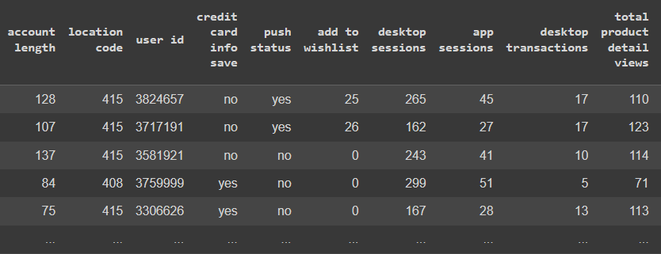
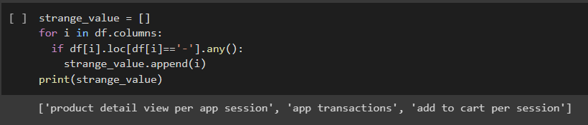
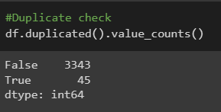
PYTHON

Slide 10
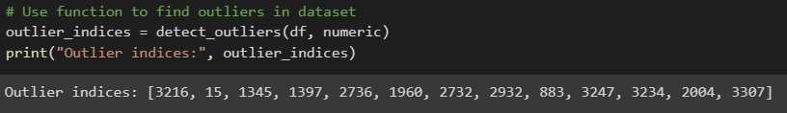
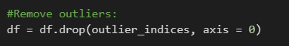
OUTLIER DETECTION
Using the interquartile range (IQR) to detect outliers in dataset

Slide 11
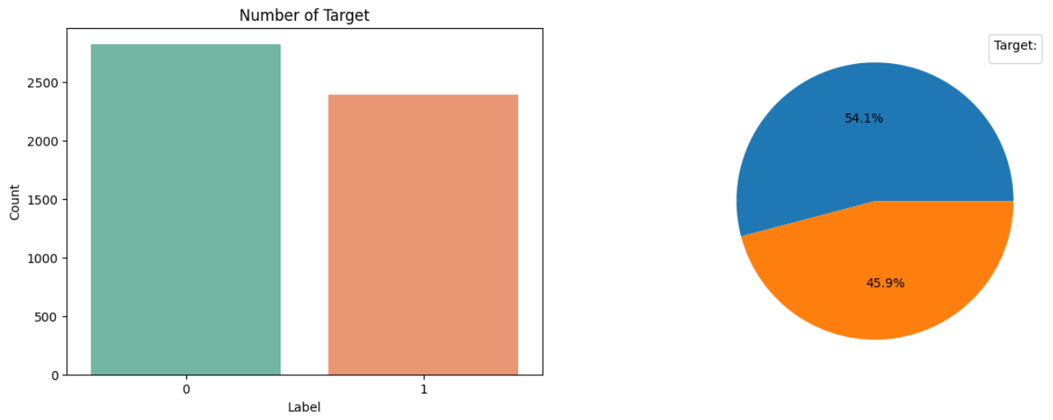
FIX TARGET BIAS
TỈ LỆ BỎ HỌC CỦA SINH VIÊN LÀ MỘT VẤN ĐỀ NAN GIẢI CHO CÁC CẤP CƠ SỞ CAO HỌC ĐỂ ĐÓNG GÓP VÀO SỰ PHÁT TRIỂN NÀY.

Slide 12
EDA
03

Slide 13
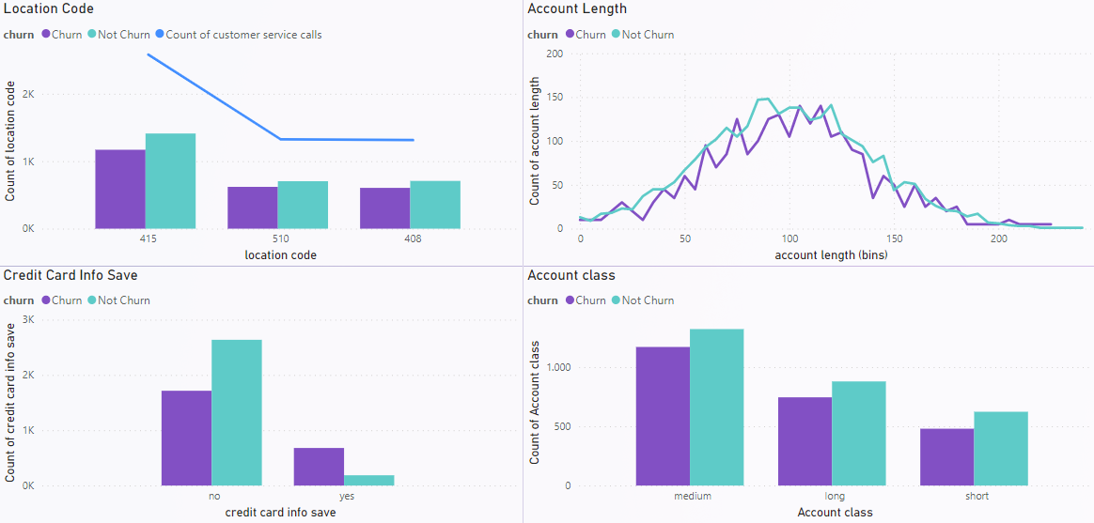
CONTEXT INFORMATION
Data is generated from 3 main areas with the most concentration in code 415
The number of days members gather from 70 to 120
Thus, it can be seen that the data set gives a fair ratio of customer segments to demographics, which will improve the representativeness of the later analysis.

Slide 14
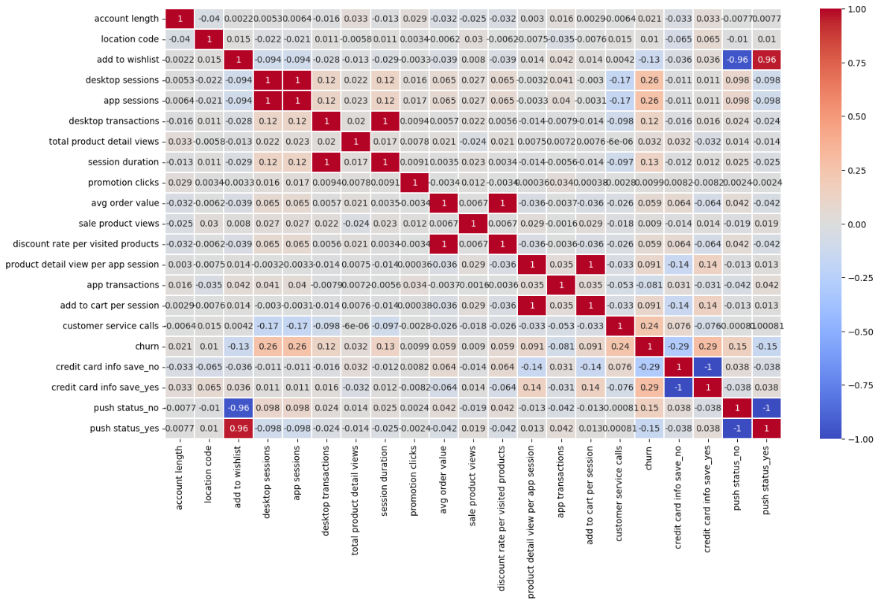
HEATMAP
PYTHON
App sessions
Desktop sessions
Session duration
Desktop transactions
Discount rate per visited products
Avg order value
Product detail view per app session
Add to cart per session

Slide 15
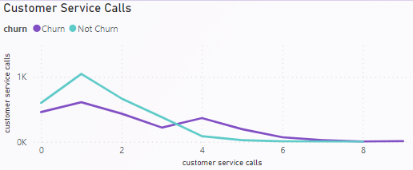
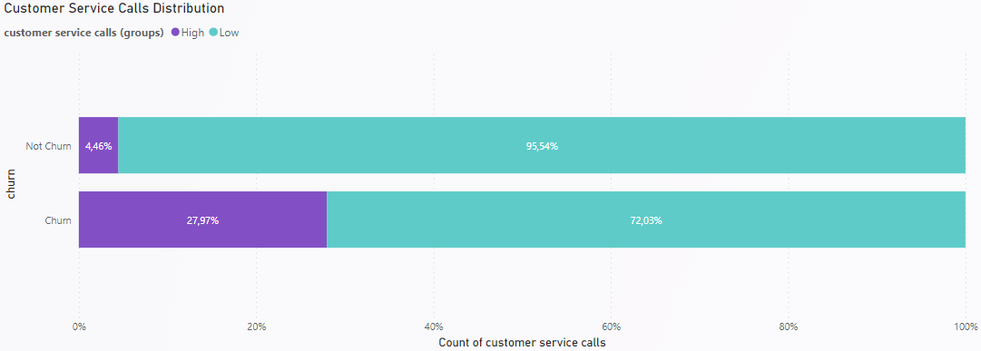
Effect of customer service calls on customer churn ability
The customer not churn group has the highest frequency concentrated on calls 1 to 3.
The customer churn continues to contact the company for the 4th time or more, especially with the number of callers increasing from 4 to 8 times and accounts for nearly 23% of customers who have stopped shopping.

Slide 16
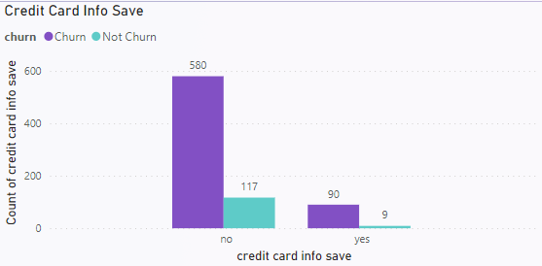
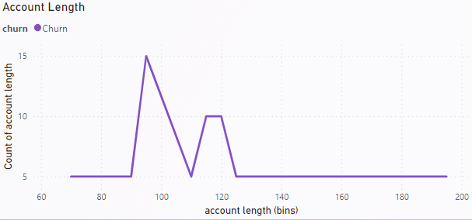
Effect of credit card info save on customer churn ability
The customer churn group accounted for 15% who saved credit card info, while about 7% in normal group
Moreover, The customer churn has 4+ support calls and saved credit card information, which is up to 90% higher in numbers than the other customer group and they are also medium lifetime members, suggesting these could be popular issues customer encounters related to the company's payment and credit regulations.

Slide 17
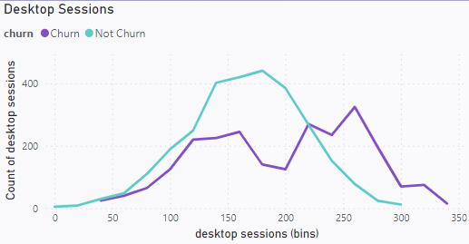
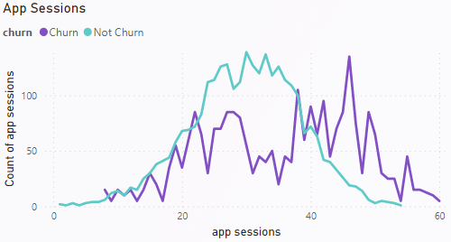
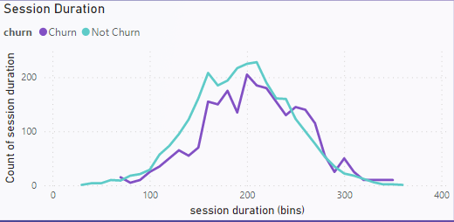
Effect of desktop and app session on customer churn ability
Customer churn group has amount of session 40% higher than normal
A large customer churn has more duration in a session for 260 seconds mark or more

Slide 18
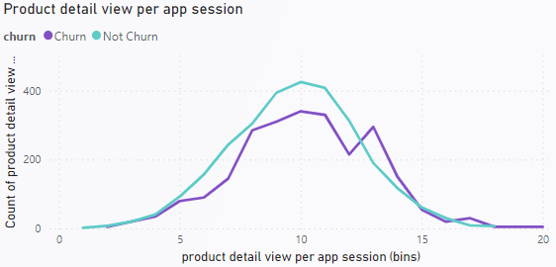
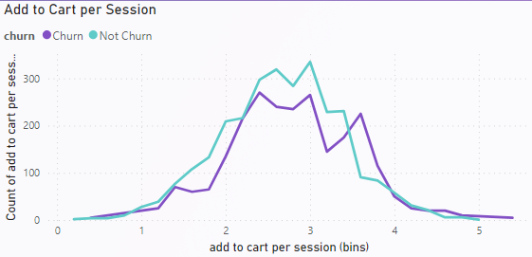
Why did customers churn group has more duration and access times?
This shows that they are still hesitant before the decision to buy again but still regularly update information and promotions of the product to consider.

Slide 19
04
FEATURE ENGINEERING

Slide 20
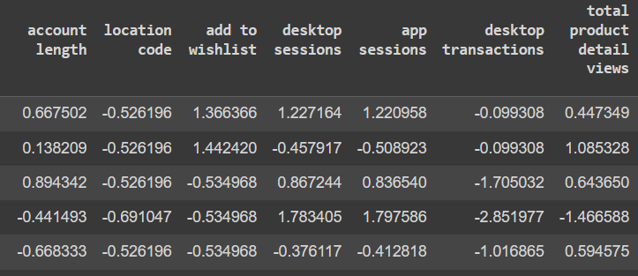
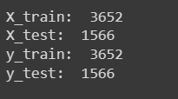
Feature scaling
Encode categorical features using the get_dummies function
Scale numerical features using the StandardScaler function
Split data into train set and test set
Split into 70-30 for train and test dataset

Slide 21
05
BUILDING AND TRAINING MODEL

Slide 22
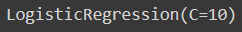
CLASSIFICATION MODELS
(Gridsearch CV)
Logistic Regression
Support Vector Classification
K-nearest neighbors
Decision Tree
Random forests

Slide 23
MODEL PERFORMANCE EVALUATION
 | Precision | Recall | F1-score | Accuracy
 | 0.76 | 0.75 | 0.75 | 0.78
 | 0.91 | 1.00 | 0.95 | 0.95
 | 0.92 | 1.00 | 0.96 | 0.96
 | 0.92 | 1.00 | 0.96 | 0.96
 | 0.97 | 1.00 | 0.99 | 0.99
Logistic Regression
Support Vector Classification
K-nearest neighbors
Decision tree
Random forests

Slide 24
MODEL PERFORMANCE EVALUATION
Decision tree
Top 2 performance model in the test
Higher performance as bringing out fast results and easier comprehensiveness by business
A little chance to give out bad results that can affect the decision
Random forests
Top 1 performance model in the test
Need more time and resources to build and maintain in order to give out better result
Higher reliability as basing on average result to determine the final

Slide 25
06
FEATURE IMPORTANCE

Slide 26
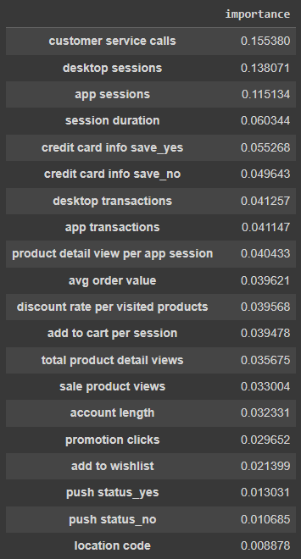
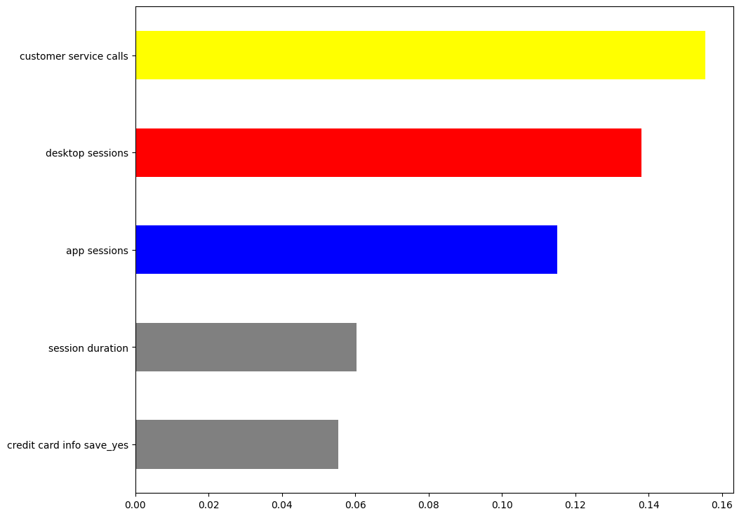
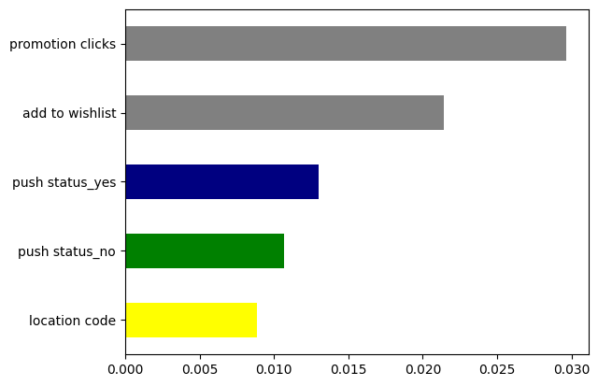
FEATURE IMPORTANCE BY RANDOM FOREST MODEL

Slide 27

RECOMMENDATION

Slide 28

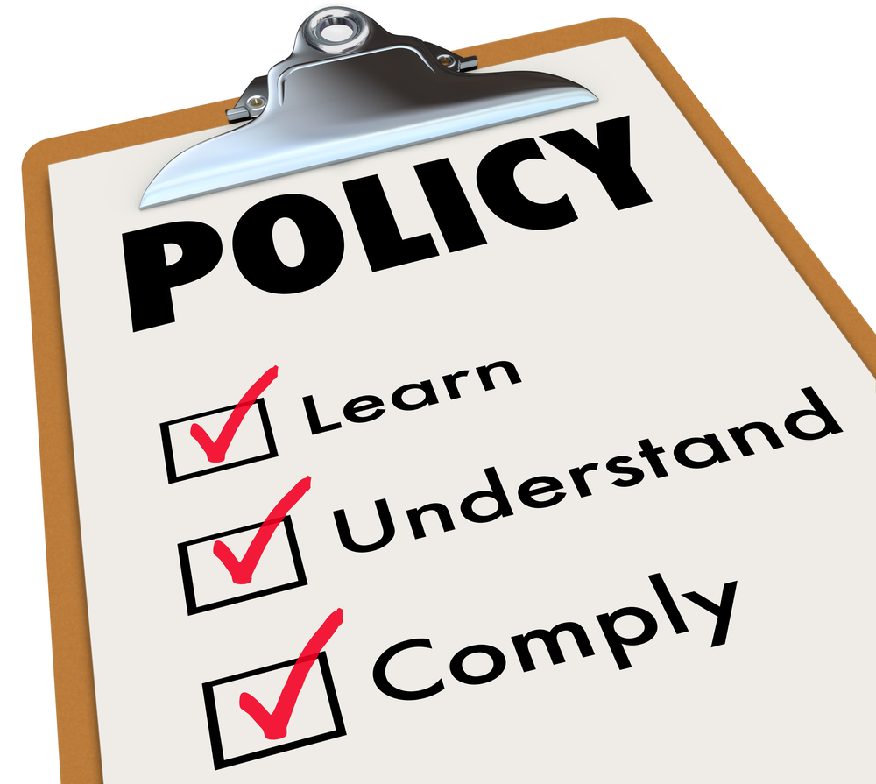

CUSTOMER CHURNS WHO HAVE MORE CONTACTS WITH CUSTOMER SERVICE
Organize follow-up training for employees to improve the ability to thoroughly solve customer problems, conduct a satisfaction survey.
Improve purchase policy and special benefits, vouchers suitable for customers who call many times reduce the possibility of customers leaving.
Collect more data to analyze the content of calls, periodically update common problems to develop quick resolution standards.

Slide 29
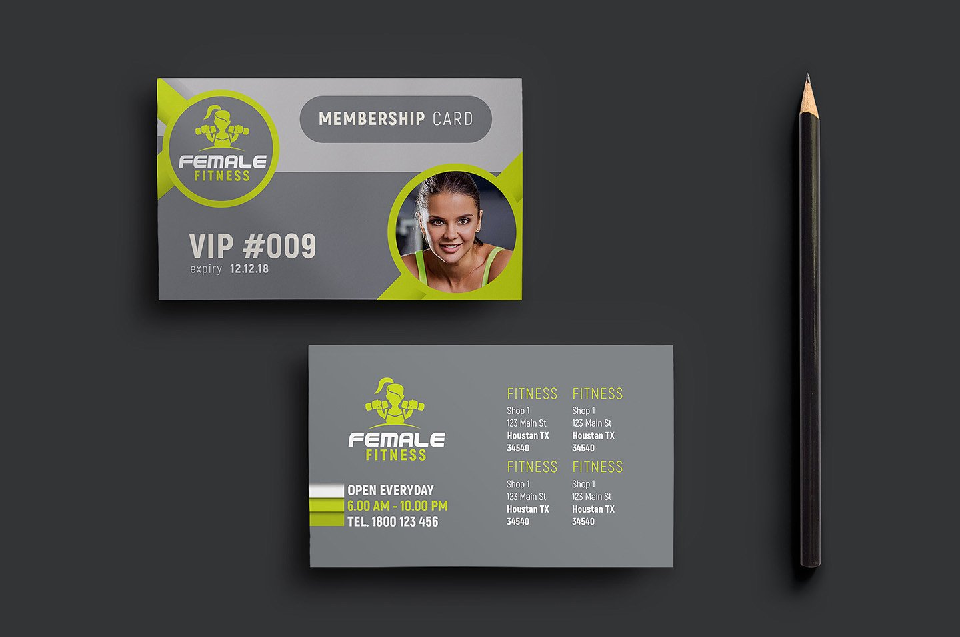

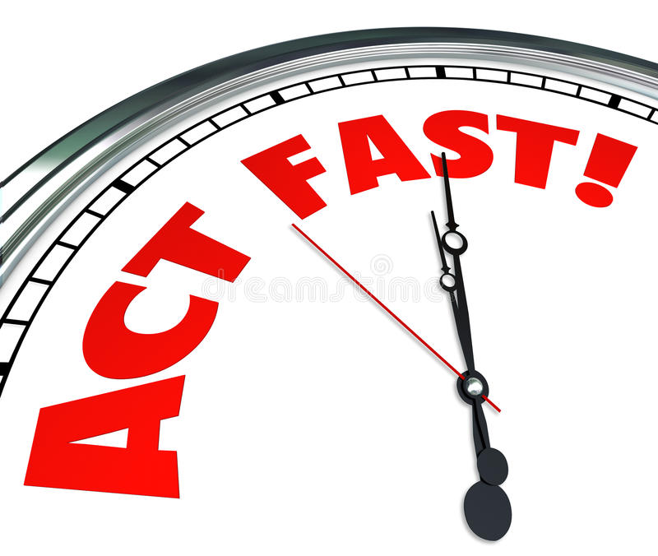

DIFFICULTIES OF CUSTOMERS IN MAKING PURCHASING DECISIONS
Proposing customers to buy membership cards to receive incentives quickly and increasingly promote customer decision-making
Push Notifications for Promotional Orders in Customer's Cart
Create time- or quantity-limited urgency for high-throughput or add-to-cart products

Slide 30

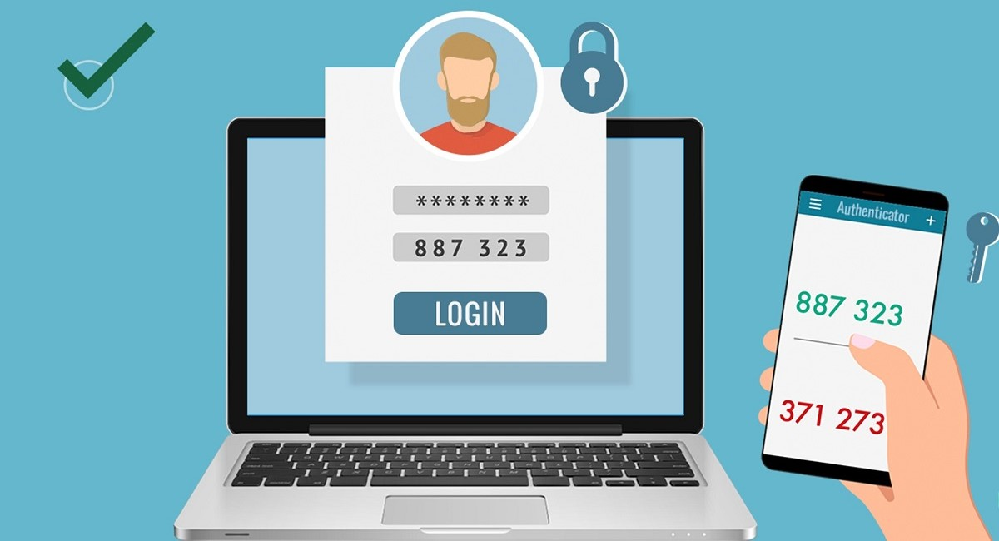

CUSTOMER PROBLEMS WITH CREDIT INFORMATION ON E-COMMERCE PLATFORMS
Strengthen and develop a team of highly qualified credit professionals to directly and thoroughly support customers' related issues
Use online tools and chatbot to increase user friendliness and save time for customers who want to find accurate information about policies
Perform multi-layer verification before actions related to credit payments or information changes

Slide 31
THE END
THANKS FOR WATCHING

